Slide 1
6. Introduction to sequential systems
Fondamenti di Elettronica
Sergio Spanò – spano@ing.uniroma2.it

Slide 2
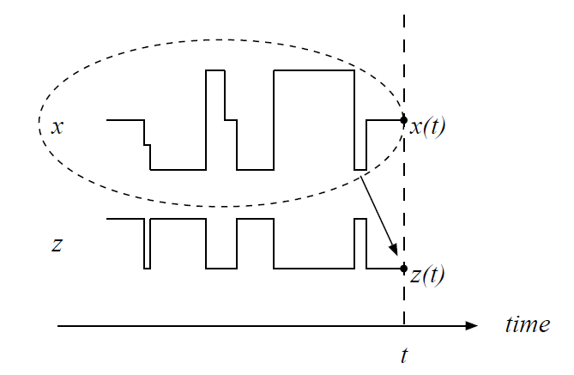
Sequential systems
In combinational systems the values of the outputs at the time t=t₀ depend only on the values of the inputs at the same time t=t₀
In sequential systems the values of the output at the time t=t₀ depend not only on the values of the inputs at the same time t=t₀ but also on the values of the input in previous time

Slide 3
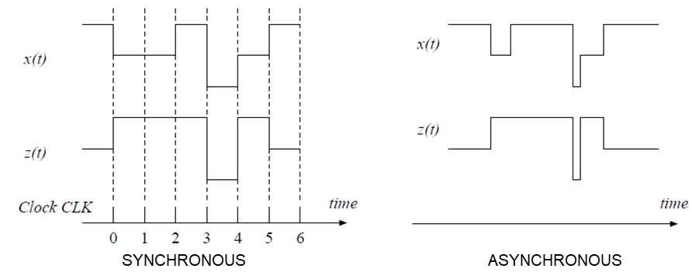
Synchronous and asynchronous systems
Sequential systems can be divided in two main groups
SYNCHRONOUS systems: signals change in defined time instants (usually managed by a control signal called clock)
ASYNCHRONOUS systems: signals can change anytime

Slide 4
State
A sequential system is characterized not only by the inputs and the outputs but also by the STATE
The STATE gives us information about the conditions of the systems
for example, consider a tank containing water. The tank level indicates its status.
Sequential systems can be described using two equations.
s(t+1) =G( s(t), x(t) ) (NEXT STATE EQUATION)
z(t) =H(s(t), x(t ) ) (OUTPUT)

Slide 5
Mealy and Moore machines
MEALY MACHINE
s(t+1) =G( s(t), x(t) ) (NEXT STATE EQUATION)
z(t) =H(s(t), x(t) ) (OUTPUT)
The output depends both on state and input
MOORE MACHINE
s(t+1) =G( s(t), x(t) ) (NEXT STATE EQUATION)
z(t) =H(s(t)) (OUTPUT)
The output depends on state

Slide 6
Sequential systems description
In order to describe sequential systems three main approaches can be used
Formulas and/or conditional syntax
Transition Tables
State diagram

Slide 7
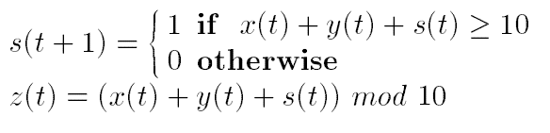
Formulas and/or conditional statements

Slide 8
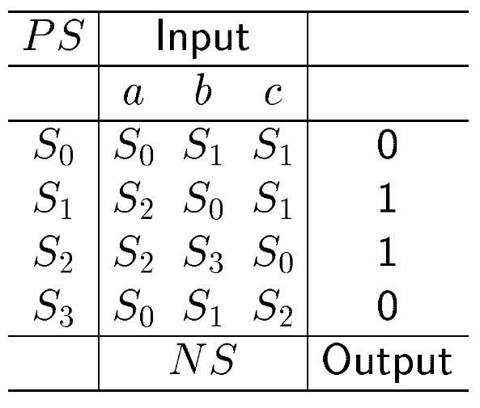
Transition table

Slide 9
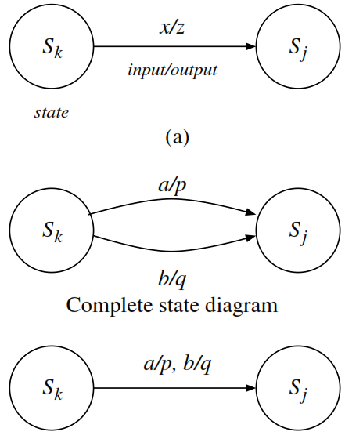
State diagram

Slide 10
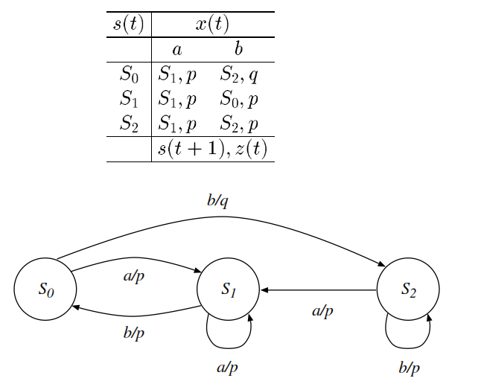
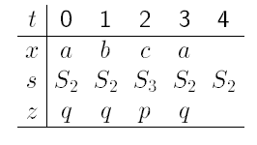
Transition table, state diagram and time behavior
It is Mealy Machine

Slide 11
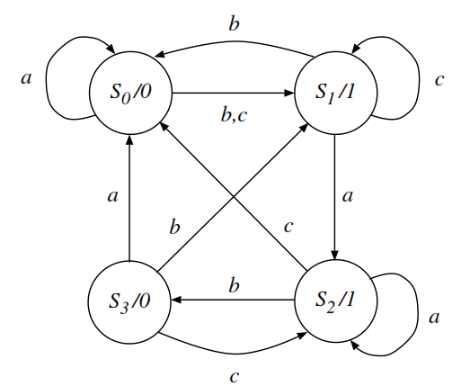
Moore machine state diagram

Slide 12
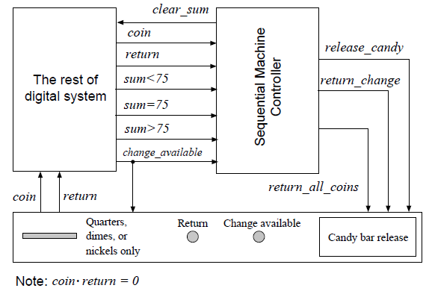
Example: vending machine 1/2

Slide 13
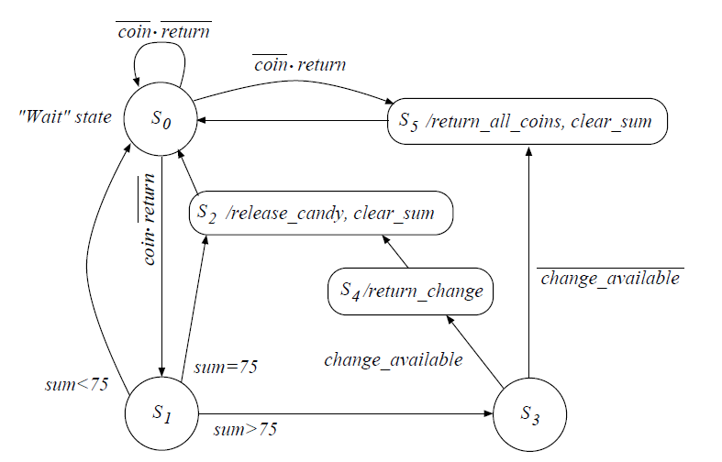
Example: vending machine 1/2

